Slide 1



Architectural style
“An Architectural style is a transformation that is imposed on the design of an entire system. The intent is to establish a structure for all components of the system.”

Slide 2
What do SE architectural styles describe?
A set of components (e.g., a database, computational modules) that perform a function required by a system.
A set of connectors that enable “communication, coordination and cooperation” among components.
Constraints that define how components can be integrated to form the system.
Semantic models that enable a designer to understand the overall properties of a system by analyzing the known properties of its constituent parts.

Slide 3
Common SE architectures
Data-centered (repository)
Client-server
Model-view-controller
Layered architectures
Microservice architecture

Slide 4
Studying SE architectural styles
Description
A brief overview of the architecture:
what does it do?
What is the rational?
Which problem does it address?
When used
Applicability:
What are the situations in which the style can be applied?
What are examples of poor designs that the style can address?
Advantages
What are the benefits of using the style?
Disadvantages
What are the probable negative consequences?

Slide 5
Data-centered (repository) architectures
Client software
Client software
Client software
Client software
Data store (repository)
Client software
Client software
Client software
Client software
Notes:
Data repository can be active or passive

Slide 6
Data-centered (repository) architectures
Description
All data in a system is managed in a central repository that is accessible to all system components. Components do not interact directly, only through the repository.
When used
You should use this pattern when you have a system in which large volumes of information are generated that has to be stored for a long time. You may also use it in data-driven systems where the inclusion of data in the repository triggers an action or tool.
Advantages
Components can be independent—they do not need to know of the existence of other components. Changes made by one component can be propagated to all components. All data can be managed consistently (e.g., backups done at the same time) as it is all in one place.
Disadvantages
The repository is a single point of failure so problems in the repository affect the whole system. May be inefficiencies in organizing all communication through the repository. Distributing the repository across several computers may be difficult.

Slide 7
Client-server architecture
Distributed system model which shows how data and processing is distributed across a range of components.
Can be implemented on a single computer.
Set of stand-alone servers which provide specific services such as printing, data management, etc.
Set of clients which call on these services.
Network which allows clients to access servers.

Slide 8
Client-server architecture
Description
In a client–server architecture, the functionality of the system is organized into services, with each service delivered from a separate server. Clients are users of these services and access servers to make use of them.
When used
Used when data in a shared database has to be accessed from a range of locations. Because servers can be replicated, may also be used when the load on a system is variable.
Advantages
The principal advantage of this model is that servers can be distributed across a network. General functionality (e.g., a printing service) can be available to all clients and does not need to be implemented by all services.
Disadvantages
Each service is a single point of failure so susceptible to denial of service attacks or server failure. Performance may be unpredictable because it depends on the network as well as the system. May be management problems if servers are owned by different organizations.

Slide 9
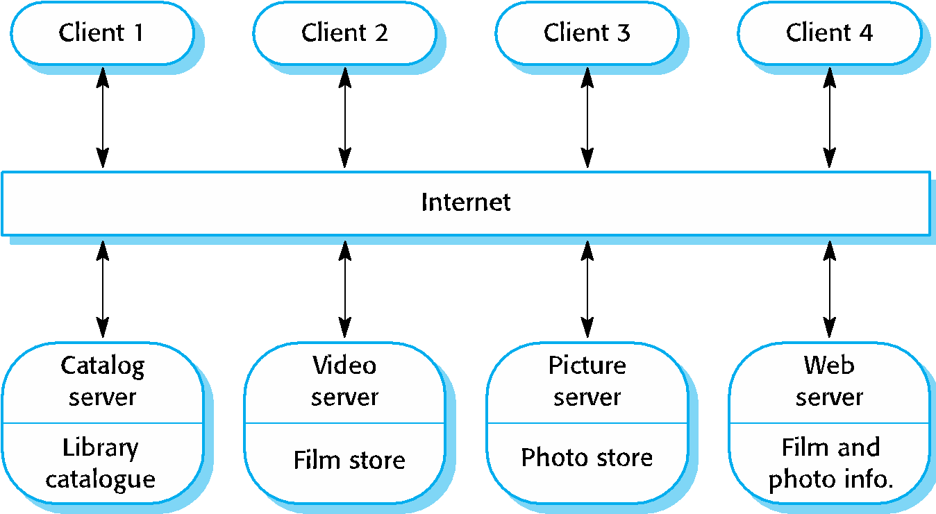
A client–server architecture for a film library

Slide 10
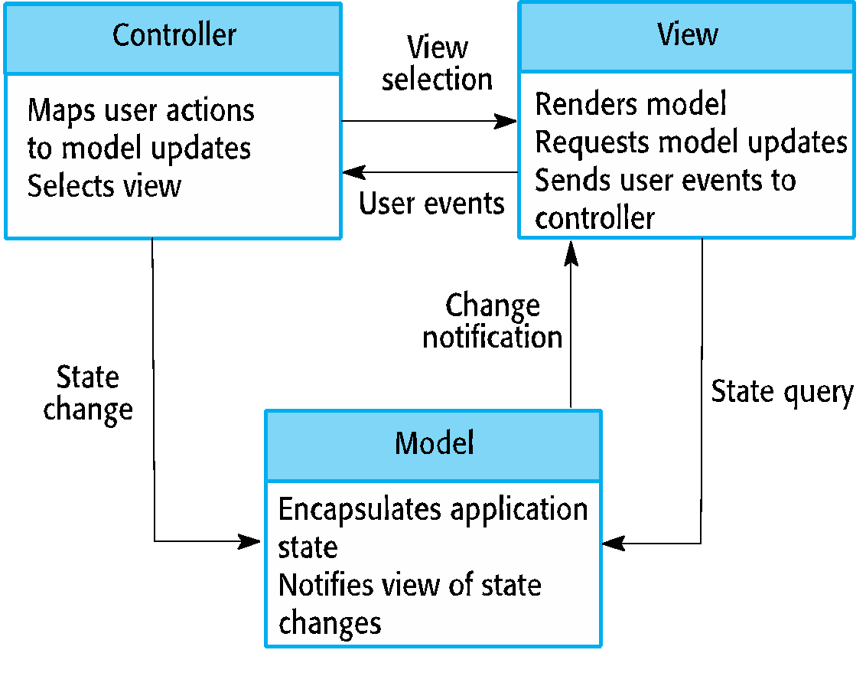
Model-View-Controller architectures

Slide 11
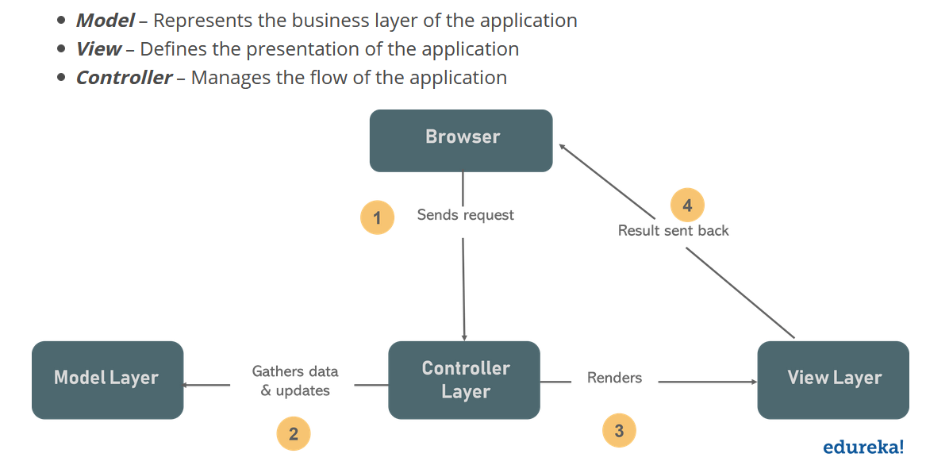
The browser on the client sends a request for a page to the controller present on the server
The controller performs the action of invoking the model, thereby, retrieving the data it needs in response to the request
The controller then gives the retrieved data to the view
The view is rendered and sent back to the client for the browser to display

Slide 12
Details of Controller and Model
Controller
The Controller is that part of the application that handles the user interaction. The controller interprets the mouse and keyboard inputs from the user, informing model and the view to change as appropriate.
A Controller sends commands to the model to update its state(E.g., Saving a specific document). The controller also sends commands to its associated view to change the view's presentation (For example scrolling a particular document).
Model
The model component stores data and its related logic. It represents data that is being transferred between controller components or any other related business logic. For example, a Controller object will retrieve the customer info from the database. It manipulates data and send back to the database or use it to render the same data.
It responds to the request from the views and also responds to instructions from the controller to update itself. It is also the lowest level of the pattern which is responsible for maintaining data.

Slide 13
Model-View-Controller (MVC) architectures
Description
Separates presentation and interaction from the system data. The system is structured into three logical components that interact with each other. The Model component manages the system data and associated operations on that data. The View component defines and manages how the data is presented to the user. The Controller component manages user interaction (e.g., key presses, mouse clicks, etc.) and passes these interactions to the View and the Model.
When used
Used when there are multiple ways to view and interact with data. Also used when the future requirements for interaction and presentation of data are unknown.
Advantages
Allows the data to change independently of its representation and vice versa. Supports presentation of the same data in different ways with changes made in one representation shown in all of them.
Disadvantages
Can involve additional code and code complexity when the data model and interactions are simple.

Slide 14
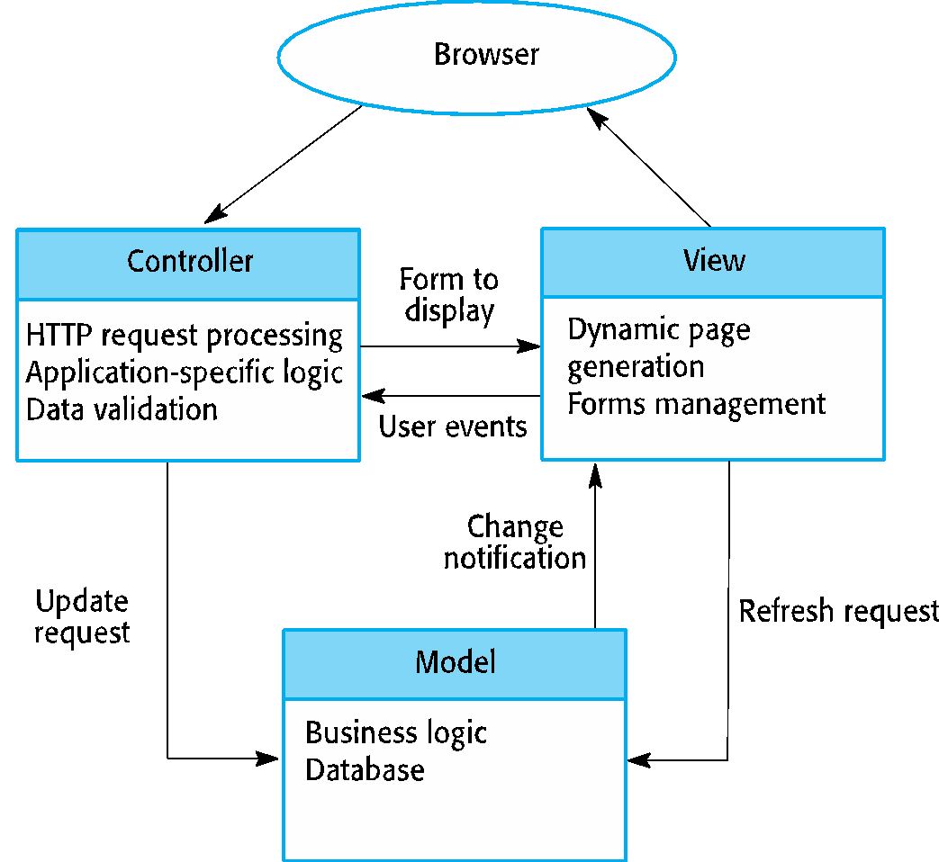
Web application architecture using the MVC pattern ( run-time architecture)

Slide 15
Layered architecture
Used to model the interfacing of sub-systems.
Organises the system into a set of layers (or abstract machines) each of which provide a set of services.
Supports the incremental development of sub-systems in different layers. When a layer interface changes, only the adjacent layer is affected.

Slide 16
Layered architectures
Description
Organizes the system into layers with related functionality associated with each layer. A layer provides services to the layer above it so the lowest-level layers represent core services that are likely to be used throughout the system.
When used
Used when building new facilities on top of existing systems; when the development is spread across several teams with each team responsibility for a layer of functionality; when there is a requirement for multi-level security.
Advantages
Allows replacement of entire layers so long as the interface is maintained. Redundant facilities (e.g., authentication) can be provided in each layer to increase the dependability of the system.
Disadvantages
In practice, providing a clean separation between layers is often difficult and a high-level layer may have to interact directly with lower-level layers rather than through the layer immediately below it. Performance can be a problem because of multiple levels of interpretation of a service request as it is processed at each layer.

Slide 17
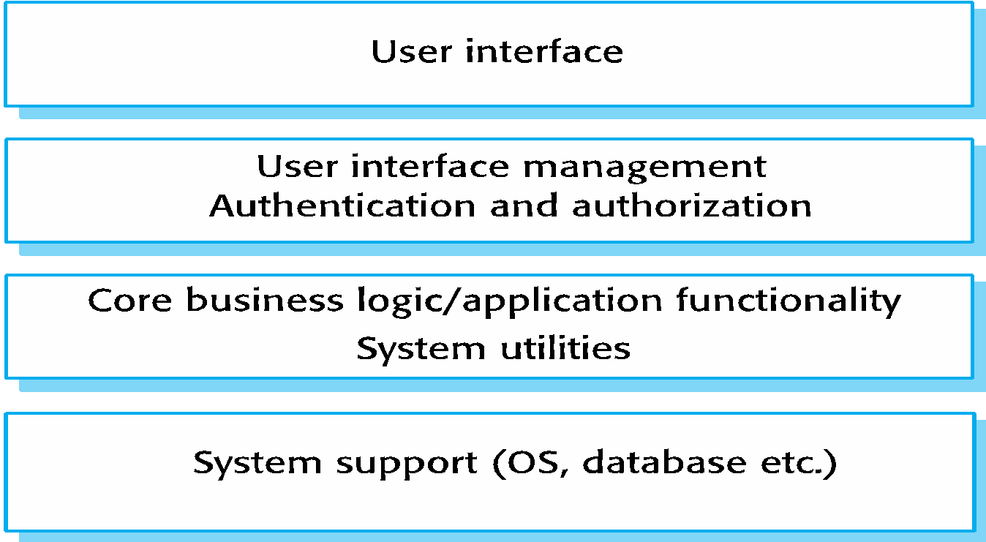
A generic layered architecture
Localize machine dependencies in inner layers, this makes it easier to provide multi-platform implementations of application. Only the inner layer need be re-implemented to take care of different OS, hardware and database

Slide 18
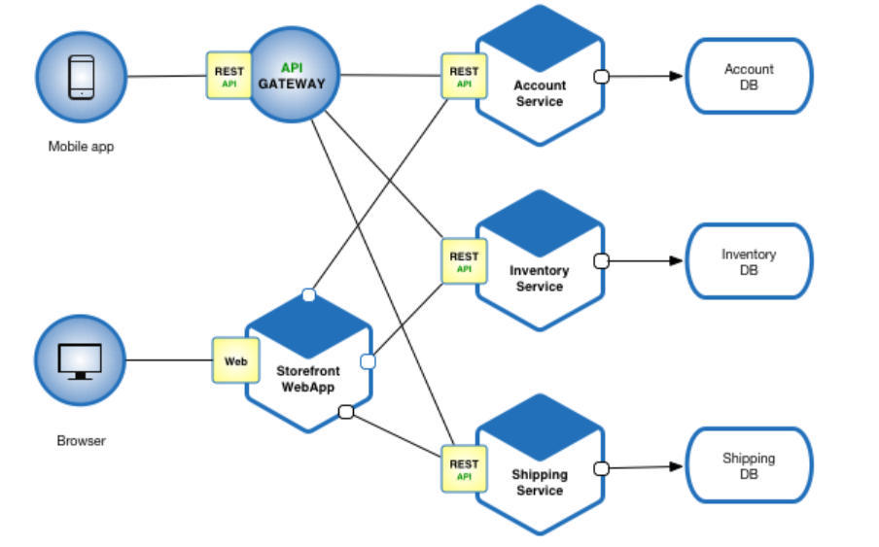
Microservice
An architectural style that structures an application as a collection of services.

Slide 19
Advantages
Enables the continuous delivery and deployment of large, complex applications.
Improved maintainability - each service is relatively small and so is easier to understand and change
Better testability - services are smaller and faster to test
Better deployability - services can be deployed independently
It enables you to organize the development effort around multiple, autonomous teams. Each team owns and is responsible for one or more services.
Each team can develop, test, deploy and scale their services independently of all of the other teams.

Slide 20
Advantages
Each microservice is relatively small:
Easier for a developer to understand
New developer can quickly become productive
The application starts faster, which makes developers more productive, and speeds up deployments

Slide 21
Advantages
Improved fault isolation. For example, if there is a memory leak in one service then only that service will be affected. The other services will continue to handle requests.
In comparison, one misbehaving component of a monolithic architecture can bring down the entire system.
Eliminates any long-term commitment to a technology stack.
When developing a new service you can pick a new technology stack.
Similarly, when making major changes to an existing service you can rewrite it using a new technology stack.

Slide 22
Drawbacks
Developers must deal with the additional complexity of creating a distributed system:
Developers must implement the inter-service communication mechanism and deal with partial failure
Implementing requests that span multiple services is more difficult
Testing the interactions between services is more difficult
Implementing requests that span multiple services requires careful coordination between the teams
Developer tools/IDEs are oriented on building monolithic applications and don’t provide explicit support for developing distributed applications.
Deployment complexity. In production, there is also the operational complexity of deploying and managing a system comprised of many different services.

Slide 23
Drawbacks
Increased memory consumption. The microservice architecture replaces N monolithic application instances with NxM services instances.
If each service runs in its own JVM (or equivalent), which is usually necessary to isolate the instances, then there is the overhead of M times as many JVM runtimes.
Moreover, if each service runs on its own VM (e.g. EC2 instance), as is the case at Netflix, the overhead is even higher.

